Slide 1

TOURISM GUIDE SYSTEM

Slide 2
1
Problem Statement
In this we define problem as in the early days people use tourist guides in the tourist places. So it is done manually. But it takes time and is costly. As we go to different places we are unable to find the details of transportation from that particular place. So here we provide the tourism guide system through online.

Slide 3
2
Proposed System
The proposed framework is a web-based program that maintains a consolidated archive of all related information and makes the travelling activities much easier and flexible. The user can get the very right information at the very right time. Customers can get the knowledge of the hotels and vehicles they are going to use in their trip prior to their starting of trip. The system allows one to quickly access the relevant details and to make the necessary travel plans. Users will choose which places they want to visit and make online travel and hotel reservations.

Slide 4
3
Modules
ADMINISTRATOR MODULE
This module includes administrator-related functions. The administrator handles all details and has access rights to add, delete, edit and view the venue, ride, route, booking, etc.
TRAVELS MODULE
This module includes information on the different travel agencies. The customer should choose the required organization based on comfort and usability.

Slide 5
3
Modules
ROUTES MODULE
This module offers information on different routes linking origins and destinations. For each path, information such as source, destination, fare, reservation details, pick up points, etc. is given.
RESERVATIONS MODULE
This module offers features that allow users to book tickets or cancel pre-booked tickets. The module keeps records of all reservations made so far and helps the administrator to confirm or deny bookings.

Slide 6
4
Requirements
Software Requirements
Languages : Python with Django Framework
Front end : Html, CSS, JS
Database : My SQL
Browser : Google Chrome
Hardware Requirements
Operating system : Windows 7 or Windows 10
Processor : Minimum Core i3
Hard disk : 340 gb

Slide 7
5
Plan of action for next review
In this review we are doing designing , and making lay-out of our project. But in next review we will present Analysis of the project, add Graphics and Design. ➢Making various database table for information storage.

Slide 8
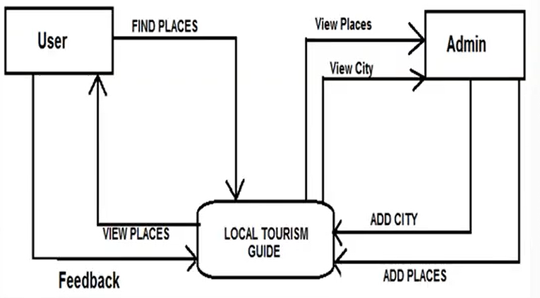
DFD(Data Flow Diagram)
6

Slide 9
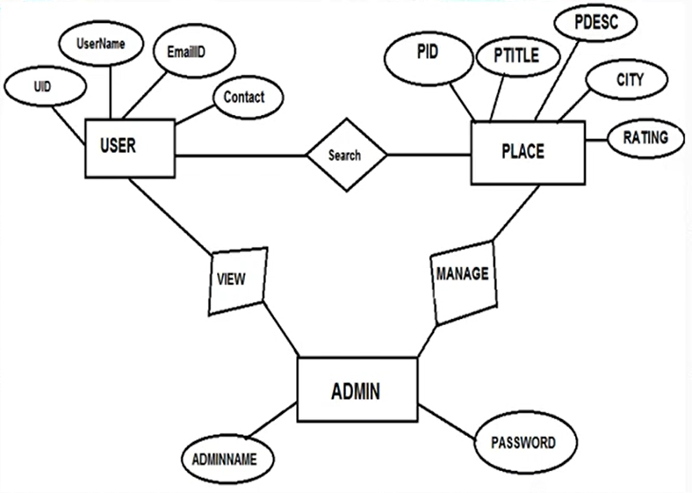
7
ER Diagram

Slide 10
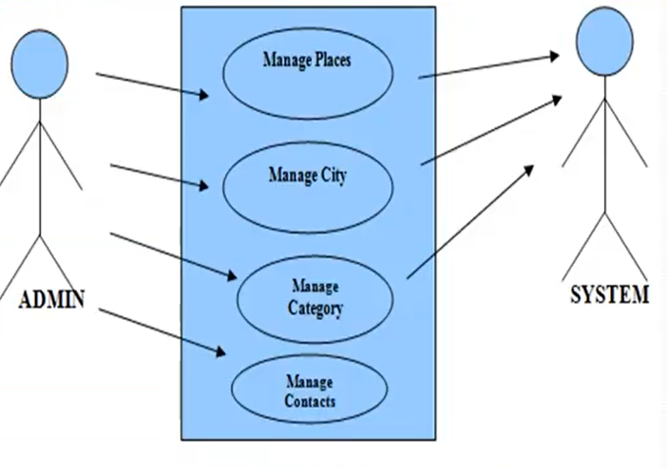
8
Use Case Diagram

Slide 11
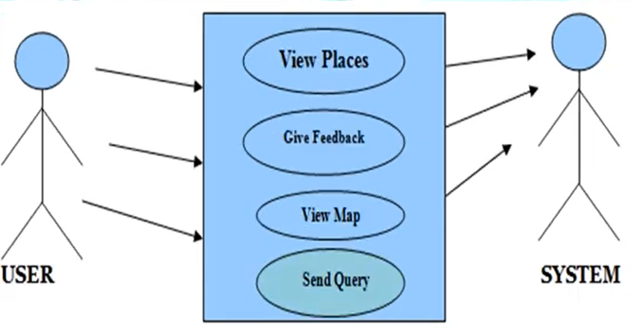
9
Use Case Diagram

Slide 12

Thank You

